Slide 1
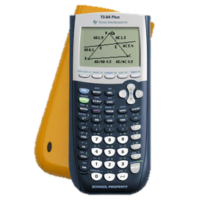
Introduction to Graphing Calculators

Slide 2

The “ON” button is at the lower left.
You should see a little rectangle on the screen once you press “ON”.
ON

Slide 3

To enter regular calculations, you enter the number and symbols such as $1−(9+9)/2$
To get the answer you press “ENTER” on the lower right
operations
Enter
numbers

Slide 4
Press “CLEAR” to clear the screen
Press “Y=” to get to the graphing utility
Y=
CLEAR

Slide 5

Enter the equation $Y=2X+2$
Use the “X,T,θ,n” button to get the variable $X$
X,T,θ,n

Slide 6
Press the “GRAPH” key to see the graph
Press the “WINDOW” key to change the window size to see better.
WINDOW
GRAPH

Slide 7
What does “TRACE” do?
TRACE

Slide 8

Let’s look at some more Graphs!
$Y=2X−3$
$Y=\left(\frac{−1}{2}\right)X−1$
$Y=X$
$Y=1.99X−1$

